Slide 1
Commercial Superscalar and VLIW Processors
Notes:
Please if anyone has additional comments please speak up

Slide 2
Superscalar Processors
Instruction
Memory
Pipeline
Issue HW
Issue Packet
Complexity of HW
This stage is pipelined in all dynamic super scalar system
0-8 instruction per cycle
Static scheduling
all pipe line hazards are checked
instructions in order
Pipeline control logic will check hazards between the instructions in execution phase and the new instruction sequences. In case of hazard, only those instructions preceding that one in the instruction sequence will be issued.

Slide 3
Example: Superscalar of degree 3 fetch decode execute write back

Slide 4
Basic Superscalar Approach
Decode/
Issue
Unit
Cache/
Memory
Fetch
Unit
Multiple Instruction
EU
EU
EU
Register File
Multi Operation
Instruction

Slide 5
Pentium 4 Pipeline Stages vs. Pentium 3 Pipeline Stages
1
Fetch
2
Fetch
3
Decode
4
Decode
5
Decode
6
Rename
7
ROB Rd
8
Rdy/Sch
9
Dispatch
10
Exec
Typical P6 Pipeline
1 2
TC Nxt IP
3 4
TC Fetch
5
Drive
6
Alloc
7 8
Rename
9
Que
10
Sch
11
Sch
12
Sch
13
Disp
14
Disp
15
RF
16
RF
17
Ex
18
Flgs
19
BrCk
20
Drive
Typical Pentium 4 Pipeline

Slide 6
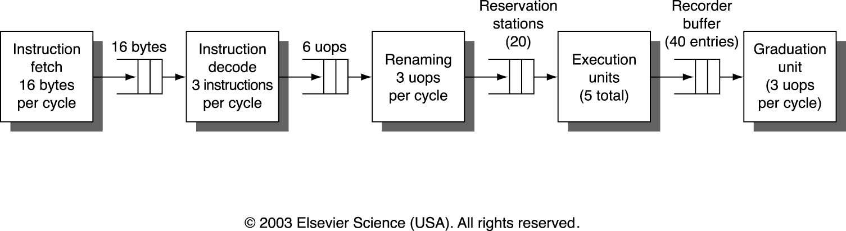
Pentium 3 Pipeline Architecture
It is a 3-way issue supersclar
It has 5 execution units (Integer ALU, integer multiply, FP multiply, FP add, FP divide)
Notes:
Dynamically Scheduled
up to 3 micro-operations (uops) per cycle
out-of-order speculative pipelining w/ register renaming & reorder buffer
instruction commit - up to 3 uops per cycle
8 stages - in-order fetch, decode & issue
3 stages - our-of-order execution (1-32 cycles)
3 stages - instruction commit

Slide 7
Pentium 3 Pipeline stages
1 | Fetch
2 | Fetch
3 | Decode
4 | Decode
5 | Decode
6 | Rename registers
7 | ROB (reordering instructions)
8 | Rdy/Sch (Scheduling Instructions to be executed)
9 | Dispatch
10 | Exec

Slide 8
Pentium 4 pipeline stages
Increasing the number of pipeline stages increases the clock frequency
  It took the industry 28 years to hit 1 GHz and only 18 months to reach 2 GHz.
  The price paid for deeper pipelines is that it is very difficult to ovoid stalls (That is why when Pentium 4 was introduced its performance was worse than Pentium 3.)
Stage | Work
1 | Trace Cache next instruction pointer
2 | Trace Cache next instruction pointer
3 | Trace Cache fetch
4 | Trace Cache fetch
5 | Drive
6 | Allocation
7 | Rename
8 | Rename
9 | Queue
10 | Schedule
11 | Schedule
12 | Schedule
13 | Dispatch
14 | Dispatch
15 | Register Files
16 | Register Files
17 | Execute
18 | Flags
19 | Branch Check
20 | Drive
It is a 5-issue supersclar processor

Slide 9
1 2
TC Nxt IP
3 4
TC Fetch
5
Drive
6
Alloc
7 8
Rename
9
Que
10
Sch
11
Sch
12
Sch
13
Disp
14
Disp
15
RF
16
RF
17
Ex
18
Flgs
19
BrCk
20
Drive
TC Nxt IP: Trace cache next instruction pointer
Pointer indicating location of next instruction.
3.2 GB/s System Interface
L2 Cache and Control
Store
AGU
L1 D-Cache and D-TLB
BTB
Schedulers
Integer RF
Load
AGU
BTB & I-TLB
Decoder
Trace Cache
Rename/Alloc
μop Queues
ALU
ALU
ALU
ALU
FP RF
FP move
FP store
μCode
ROM
Fmul
Fadd
MMX
SSE

Slide 10
1 2
TC Nxt IP
3 4
TC Fetch
5
Drive
6
Alloc
7 8
Rename
9
Que
10
Sch
11
Sch
12
Sch
13
Disp
14
Disp
15
RF
16
RF
17
Ex
18
Flgs
19
BrCk
20
Drive
TC Fetch: Trace cache fetch
Read the decoded instructions (uOPs)
3.2 GB/s System Interface
L2 Cache and Control
Store
AGU
L1 D-Cache and D-TLB
BTB
Schedulers
Integer RF
Load
AGU
BTB & I-TLB
Decoder
Trace Cache
Rename/Alloc
μop Queues
ALU
ALU
ALU
ALU
FP RF
FP move
FP store
μCode
ROM
Fmul
Fadd
MMX
SSE

Slide 11
1 2
TC Nxt IP
3 4
TC Fetch
5
Drive
6
Alloc
7 8
Rename
9
Que
10
Sch
11
Sch
12
Sch
13
Disp
14
Disp
15
RF
16
RF
17
Ex
18
Flgs
19
BrCk
20
Drive
Drive: Wire delay
Drive the uOPs to the allocator
3.2 GB/s System Interface
L2 Cache and Control
Store
AGU
L1 D-Cache and D-TLB
BTB
Schedulers
Integer RF
Load
AGU
BTB & I-TLB
Decoder
Trace Cache
Rename/Alloc
μop Queues
ALU
ALU
ALU
ALU
FP RF
FP move
FP store
μCode
ROM
Fmul
Fadd
MMX
SSE

Slide 12
1 2
TC Nxt IP
3 4
TC Fetch
5
Drive
6
Alloc
7 8
Rename
9
Que
10
Sch
11
Sch
12
Sch
13
Disp
14
Disp
15
RF
16
RF
17
Ex
18
Flgs
19
BrCk
20
Drive
Alloc: Allocate resources required for execution. The
resources include Load buffers, Store buffers, etc..
3.2 GB/s System Interface
L2 Cache and Control
Store
AGU
L1 D-Cache and D-TLB
BTB
Schedulers
Integer RF
Load
AGU
BTB & I-TLB
Decoder
Trace Cache
Rename/Alloc
μop Queues
ALU
ALU
ALU
ALU
FP RF
FP move
FP store
μCode
ROM
Fmul
Fadd
MMX
SSE

Slide 13
1 2
TC Nxt IP
3 4
TC Fetch
5
Drive
6
Alloc
7 8
Rename
9
Que
10
Sch
11
Sch
12
Sch
13
Disp
14
Disp
15
RF
16
RF
17
Ex
18
Flgs
19
BrCk
20
Drive
Rename: Register renaming
3.2 GB/s System Interface
L2 Cache and Control
Store
AGU
L1 D-Cache and D-TLB
BTB
Schedulers
Integer RF
Load
AGU
BTB & I-TLB
Decoder
Trace Cache
Rename/Alloc
μop Queues
ALU
ALU
ALU
ALU
FP RF
FP move
FP store
μCode
ROM
Fmul
Fadd
MMX
SSE

Slide 14
1 2
TC Nxt IP
3 4
TC Fetch
5
Drive
6
Alloc
7 8
Rename
9
Que
10
Sch
11
Sch
12
Sch
13
Disp
14
Disp
15
RF
16
RF
17
Ex
18
Flgs
19
BrCk
20
Drive
Que: Write into the uOP Queue
uOPs are placed into the queues, where they are held until there is room in the schedulers
3.2 GB/s System Interface
L2 Cache and Control
Store
AGU
L1 D-Cache and D-TLB
BTB
Schedulers
Integer RF
Load
AGU
BTB & I-TLB
Decoder
Trace Cache
Rename/Alloc
μop Queues
ALU
ALU
ALU
ALU
FP RF
FP move
FP store
μCode
ROM
Fmul
Fadd
MMX
SSE

Slide 15
1 2
TC Nxt IP
3 4
TC Fetch
5
Drive
6
Alloc
7 8
Rename
9
Que
10
Sch
11
Sch
12
Sch
13
Disp
14
Disp
15
RF
16
RF
17
Ex
18
Flgs
19
BrCk
20
Drive
Sch: Schedule
Write into the schedulers and compute dependencies. Watch for dependency to resolve.
3.2 GB/s System Interface
L2 Cache and Control
Store
AGU
L1 D-Cache and D-TLB
BTB
Schedulers
Integer RF
Load
AGU
BTB & I-TLB
Decoder
Trace Cache
Rename/Alloc
μop Queues
ALU
ALU
ALU
ALU
FP RF
FP move
FP store
μCode
ROM
Fmul
Fadd
MMX
SSE

Slide 16
1 2
TC Nxt IP
3 4
TC Fetch
5
Drive
6
Alloc
7 8
Rename
9
Que
10
Sch
11
Sch
12
Sch
13
Disp
14
Disp
15
RF
16
RF
17
Ex
18
Flgs
19
BrCk
20
Drive
Disp: Dispatch
Send the uOPs to the appropriate execution unit.
3.2 GB/s System Interface
L2 Cache and Control
Store
AGU
L1 D-Cache and D-TLB
BTB
Schedulers
Integer RF
Load
AGU
BTB & I-TLB
Decoder
Trace Cache
Rename/Alloc
μop Queues
ALU
ALU
ALU
ALU
FP RF
FP move
FP store
μCode
ROM
Fmul
Fadd
MMX
SSE

Slide 17
1 2
TC Nxt IP
3 4
TC Fetch
5
Drive
6
Alloc
7 8
Rename
9
Que
10
Sch
11
Sch
12
Sch
13
Disp
14
Disp
15
RF
16
RF
17
Ex
18
Flgs
19
BrCk
20
Drive
RF: Register File
Read the register file. These are the source(s) for the pending operation (ALU or other).
3.2 GB/s System Interface
L2 Cache and Control
Store
AGU
L1 D-Cache and D-TLB
BTB
Schedulers
Integer RF
Load
AGU
BTB & I-TLB
Decoder
Trace Cache
Rename/Alloc
μop Queues
ALU
ALU
ALU
ALU
FP RF
FP move
FP store
μCode
ROM
Fmul
Fadd
MMX
SSE

Slide 18
1 2
TC Nxt IP
3 4
TC Fetch
5
Drive
6
Alloc
7 8
Rename
9
Que
10
Sch
11
Sch
12
Sch
13
Disp
14
Disp
15
RF
16
RF
17
Ex
18
Flgs
19
BrCk
20
Drive
Ex: Execute
Execute the uOPs on the appropriate execution port.
3.2 GB/s System Interface
L2 Cache and Control
Store
AGU
L1 D-Cache and D-TLB
BTB
Schedulers
Integer RF
Load
AGU
BTB & I-TLB
Decoder
Trace Cache
Rename/Alloc
μop Queues
ALU
ALU
ALU
ALU
FP RF
FP move
FP store
μCode
ROM
Fmul
Fadd
MMX
SSE

Slide 19
1 2
TC Nxt IP
3 4
TC Fetch
5
Drive
6
Alloc
7 8
Rename
9
Que
10
Sch
11
Sch
12
Sch
13
Disp
14
Disp
15
RF
16
RF
17
Ex
18
Flgs
19
BrCk
20
Drive
Flgs: Flags
Compute flags (zero, negative, etc..). These are typically input to a branch instruction.
3.2 GB/s System Interface
L2 Cache and Control
Store
AGU
L1 D-Cache and D-TLB
BTB
Schedulers
Integer RF
Load
AGU
BTB & I-TLB
Decoder
Trace Cache
Rename/Alloc
μop Queues
ALU
ALU
ALU
ALU
FP RF
FP move
FP store
μCode
ROM
Fmul
Fadd
MMX
SSE

Slide 20
1 2
TC Nxt IP
3 4
TC Fetch
5
Drive
6
Alloc
7 8
Rename
9
Que
10
Sch
11
Sch
12
Sch
13
Disp
14
Disp
15
RF
16
RF
17
Ex
18
Flgs
19
BrCk
20
Drive
Br Ck: Branch Check
The branch operation compares result of actual branch direction with the prediction.
3.2 GB/s System Interface
L2 Cache and Control
Store
AGU
L1 D-Cache and D-TLB
BTB
Schedulers
Integer RF
Load
AGU
BTB & I-TLB
Decoder
Trace Cache
Rename/Alloc
μop Queues
ALU
ALU
ALU
ALU
FP RF
FP move
FP store
μCode
ROM
Fmul
Fadd
MMX
SSE

Slide 21
1 2
TC Nxt IP
3 4
TC Fetch
5
Drive
6
Alloc
7 8
Rename
9
Que
10
Sch
11
Sch
12
Sch
13
Disp
14
Disp
15
RF
16
RF
17
Ex
18
Flgs
19
BrCk
20
Drive
Drive: Wire delay
Drive the result of the branch check to the front end of the machine.
3.2 GB/s System Interface
L2 Cache and Control
Store
AGU
L1 D-Cache and D-TLB
BTB
Schedulers
Integer RF
Load
AGU
BTB & I-TLB
Decoder
Trace Cache
Rename/Alloc
μop Queues
ALU
ALU
ALU
ALU
FP RF
FP move
FP store
μCode
ROM
Fmul
Fadd
MMX
SSE

Slide 22
Commercial EPIC Processors
Itanium
Notes:
Please if anyone has additional comments please speak up

Slide 23
Itanium® Processor Family Architecture
EPIC: explicitly parallel instruction computing
Instruction encoding
  Bundles and templates
Large register resources
  128 integer
  128 floating point
Support for
  Software pipelining
  Predication
  Speculation (Control, Data, Load)

Slide 24
EPIC – Explicitly Parallel Instruction Computing
Focused on parallel execution
Instructions are issued in bundles
Instructions distributed among processor’s execution units according to type
Currently up to two complete bundles can be dispatched per clock cycle
  Pipeline stages: 10 (Itanium®1), 8 (Itanium® 2)

Slide 25
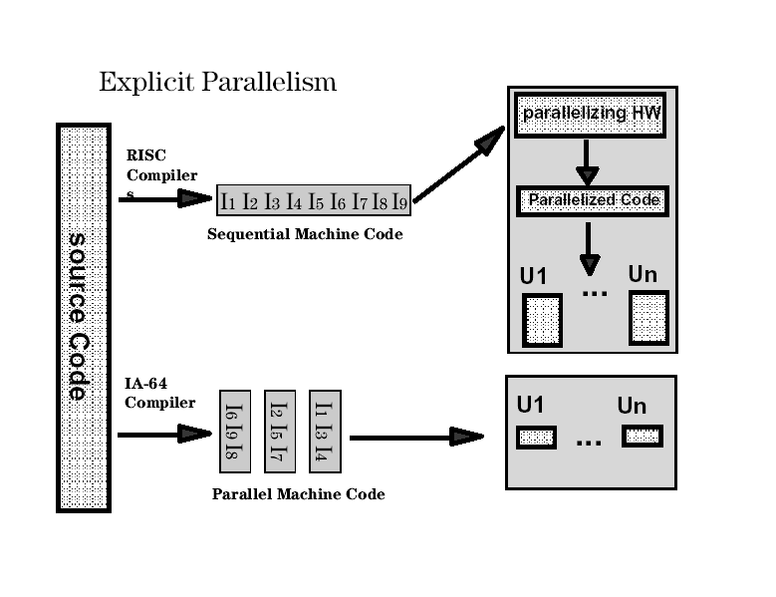

Slide 26
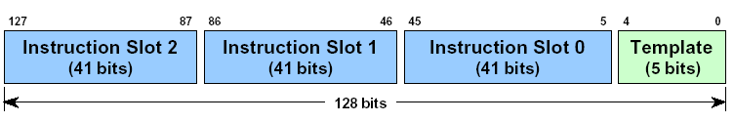
Instruction Format: Bundles & Templates
Bundle
  Set of three instructions (41 bits each)
Template
  Identifies types of instructions in bundle

Slide 27
Instruction Format: Bundles & Templates
Instruction types
  M: Memory
  I: Shifts and multimedia
  A: Integer Arithmetic and Logical Unit
  B: Branch
  F: Floating point
  L+X: Long (move, branch, …)
Notes:
Intel defines several instruction types denoted by a letter.
The template encodes the 3 instructions in a bundle.
These 3 instruction can be excuted in parallel.

Slide 28
Explicitly Parallel Instruction Computing
EPIC
S2
S1
S0
T
128-bit instruction bundles from I-cache
Fetch one or more bundles for execution
(Implementation, Itanium® takes two.)
Processor
Try to execute all instructions in
parallel, depending on available units.
functional units
MEM
MEM
MEM
MEM
INT
INT
INT
INT
FP
FP
FP
FP
B
B
B
B
B
B
Retired instruction bundles
Notes:
How are instructions executed by the machine.
The goal is to schedule bundles so that most of the excution units have work to do.
Itanium(Merced) pulls in 2 bundles at a time and tries to execute them.
Subsequent implementation will have more execution units

Slide 29
Itanium® fetches 2 bundles at a time for execution.
They may or may not execute in parallel.
Handwritten code
Instruction bundles
Execution
instr
instr
instr ;;
instr
instr ;;
instr
intsr
instr
instr
instr ;;
instr
instr ;;
instr
…
Code generator
Fetch
instr instr instr tmpl
instr instr instr tmpl
instr instr nop tmpl
instr nop nop tmpl
instr instr nop tmpl
instr instr nop tmpl
intsr instr instr tmpl
…
instr instr instr tmpl
instr instr instr tmpl
Can the bundle pair
Execute in parallel ?
Code generator creates bundles,
possibly including nops.
There are two difficulties:
Finding instruction triplets matching the defined templates.
Matching pairs of bundles that can execute in parallel.
Notes:
Handwritten code: It is important to not forget stops, since a stop declares data independance!
Code generated by the compiler might include NOPs if there is no template available or no exec unit is available

Slide 30
Today‘s Architecture Challenges
Performance barriers :
  Memory latency
  Branches
  Loop pipelining and call / return overhead
  Hardware-based instruction scheduling
  Unable to efficiently schedule parallel execution
  Too few registers
  Unable to fully utilize multiple execution units

Slide 31
Improving Performance
To achieve improved performance, Itanium(R) architecture code accomplishes the following:
  Increases instruction level parallelism (ILP)
  Improves branch handling
  Hides memory latencies

Slide 32
Instruction level parallelism (ILP)
Increase ILP by:
More resources
    Large register files
    Avoiding register contention
3-instruction wide word
    Bundle
    Facilitates parallel processing of instructions
Enabling the compiler/assembly writer to explicitly indicate parallelism

Slide 33
Itanium 8-stage Pipelines
L1D1
Memory
L1D2
L1D3
IPG
ROT
EXP
REN
REG
Int
EXE
DET
WRB
Instruction Buffer
MultiMedia
MM1
MM2
FP1
Floating Point
FP2
FP3
FP4
In-order issue, out-of-order completion
  All functional units are fully pipelined
Small branch misprediction penalties

